Slide 1
Post-quantum Crypto Primitives (Public-key Encryption & Key Exchange)
Lake Bu
ASCS Lab

Slide 2
Presentation Flow
Security problems brought up by quantum computers
How pressing is the security issue?
RSA’s vulnerability under quantum computing
Public-key systems for post-quantum era
Code-based encryption
Lattice-based encryption
Hardware implementation for the primitives

Slide 3
Presentation Flow
Security problems brought up by quantum computers
How pressing is the security issue?
RSA’s vulnerability under quantum computing
Public-key systems for post-quantum era
Code-based encryption
Lattice-based encryption
Hardware implementation for the primitives

Slide 4
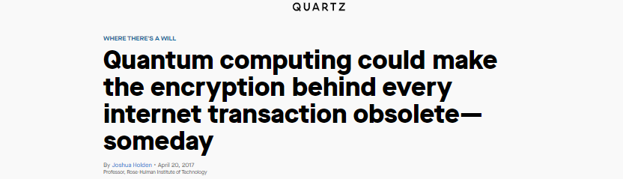
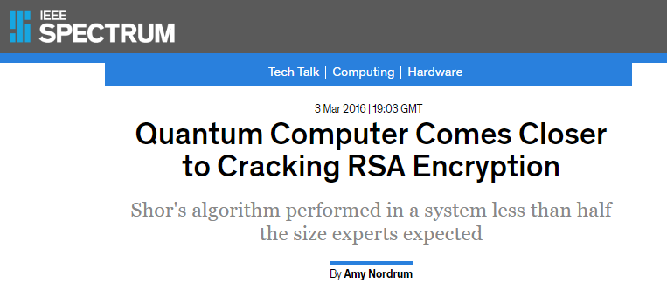
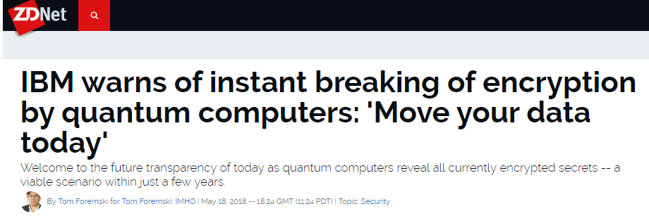
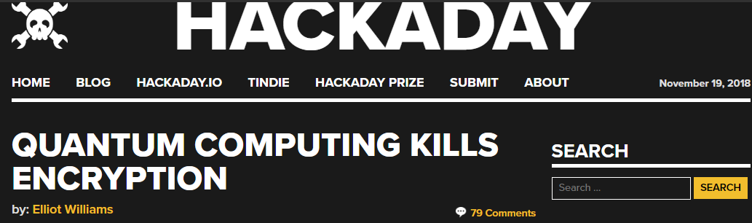
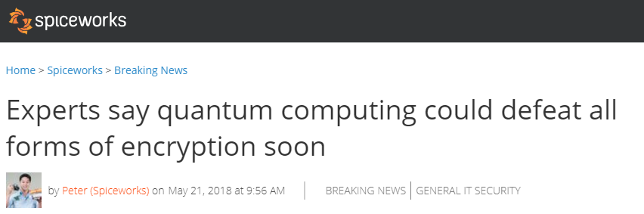
1. What Some Have Said About Quantum Computers

Slide 5

1. What Some Have Said About Quantum Computers
Quantum
Computer
Encryption

Slide 6
2. The Actual Situation Now
Who is considered as non-post-quantum secure?
Algorithm | Secure in Post-quantum Era?
RSA-1024, -2048, -4096 | No
Elliptic Curve Crypto (ECC)-256, -521 | No
Diffie-Hellman | No
ECC Diffie-Hellman | No
AES-128, -192 | No

Slide 7
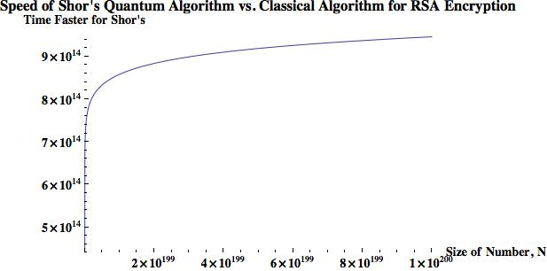
2. The Actual Situation Now
Who is considered as non-post-quantum secure?
*
To break a 768-bit (232 digits) RSA:
2 years for a current super computer
1 nanosecond for a quantum computer
(log N)²(log(log (N))(log(log(log(N)))
N: key size in decimal digits
* Zak Burkley, The Teachings of a Quantum Cat, 2016

Slide 8
3. One Question
Can we increase the key size of some popular encryption schemes, so that they can be post-quantum secure?
Maybe yes, maybe no.
Table II. Equivalent Security Levels of AES and RSA under Attacks from Classic and Quantum Computers *
Attack Platform | Symmetric Encryption |  |  | Asymmetric (Public-key) Encryption
 | Algorithm | Key Size | Security Level | Algorithm | Key Size | Security Level
Classic Computers | AES-128 | 128 | 128 | RSA-2048 | 2,048 | 112
 | AES-256 | 256 | 256 | RSA-15360 | 15,360 | 256
Quantum Computers | AES-128 | 128 | 64 | RSA-2048 | 2,048 | 25
 | AES-256 | 256 | 128 | RSA-15360 | 15,360 | 31
*
* TechBeacon, Waiting for quantum computing: Why encryption has nothing to worry about, 2018

Slide 9
3. One Question
Can we increase the key size of some popular encryption schemes, so that they can be post-quantum secure?
Maybe yes, maybe no.
Table II. Equivalent Security Levels of AES and RSA under Attacks from Classic and Quantum Computers *
Attack Platform | Symmetric Encryption |  |  | Asymmetric (Public-key) Encryption
 | Algorithm | Key Size | Security Level | Algorithm | Key Size | Security Level
Classic Computers | AES-128 | 128 | 128 | RSA-2048 | 2,048 | 112
 | AES-256 | 256 | 256 | RSA-15360 | 15,360 | 256
Quantum Computers | AES-128 | 128 | 64 | RSA-2048 | 2,048 | 25
 | AES-256 | 256 | 128 | RSA-15360 | 15,360 | 31
*
Grover’s algorithm
Shor’s algorithm
* TechBeacon, Waiting for quantum computing: Why encryption has nothing to worry about, 2018

Slide 10
Presentation Flow
Security problems brought up by quantum computers
How pressing is the security issue?
RSA’s vulnerability under quantum computing
Public-key systems for post-quantum era
Code-based encryption
Lattice-based encryption
Hardware implementation for the primitives

Slide 11
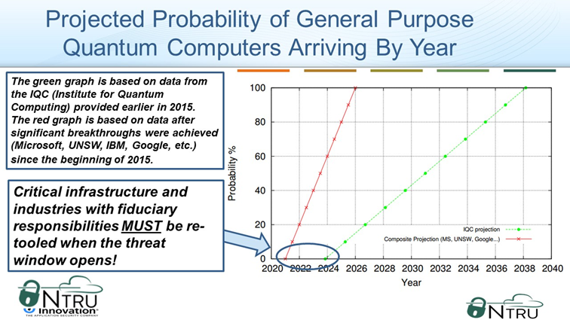
4. How Pressing is the Issue?
The Timeline
*
(23 yr)
(11 yr)
(1 ~ 5 yr)
* Lee Wilson, The Rise of Quantum Computers – The Current State of Cryptographic Affairs, 2016

Slide 12
4. How Pressing is the Issue?
The Timeline
*
(19 yr)
(7 yr)
(1 ~ 5 yr)
* Lee Wilson, The Rise of Quantum Computers – The Current State of Cryptographic Affairs, 2016

Slide 13
4. How Pressing is the Issue?
The Timeline
*
(19 yr)
(7 yr)
(1 ~ 5 yr)
* Lee Wilson, The Rise of Quantum Computers – The Current State of Cryptographic Affairs, 2016

Slide 14

4. How Pressing is the Issue?
What do people say?
Nadia Heninger et. al., Post-Quantum RSA, 2017
“RSA is not entirely dead even if quantum computers are practical”
Proposed a terabyte-sized key, taking 5 days to generate

Slide 15
4. How Pressing is the Issue?
What do people say?
Nadia Heninger et. al., Post-Quantum RSA, 2017
“RSA is not entirely dead even if quantum computers are practical”
Proposed a terabyte-sized key, taking 5 days to generate
Scott Aaronson, director of the Quantum Information Center at UT, Austin
“The encryption and decryption cost is terrible…”
“Using enormous RSA keys is extremely vulnerable to even a modest improvement in algorithms or hardware”

Slide 16


4. How Pressing is the Issue?
What do companies/institutes say?
Microsoft Research
5 years
NIST
15 years

Slide 17
4. How Pressing is the Issue?
What do companies/institutes say?
Microsoft Research
5 years
NIST
15 years
Evaluating 69 submissions of post-quantum encryption schemes, to bring up a possible standard (like AES):
21 lattice-based
18 code-based
Some hash-based
Some others

Slide 18
4. How Pressing is the Issue?
Current Situation of Quantum Computers
2011: 14 calcium ion qubits
2017: IBM 50-qubit quantum computer
2018: Google 72-qubit quantum computer
2018: 16 superconducting qubits
2018: 18 fully entangled photon qubits

Slide 19
4. How Pressing is the Issue?
Current Situation of Quantum Computers
2011: 14 calcium ion qubits
2017: IBM 50-qubit quantum computer
2018: Google 72-qubit quantum computer
2018: 16 superconducting qubits
2018: 18 fully entangled photon qubits
2019: IBM Q-system 20-qubit commercialized
Major Things that Need to Be Done
Increasing the size (# of qubits)
Error correction (need even more # of qubits)
Computation verification (of its correctness)
Quantum Supremacy: 49 qubits, and a two-qubit error below 0.5% *
* Google Quantum AI Lab: A Preview of Bristlecone, Google’s New Quantum Processor, 2018

Slide 20
Presentation Flow
Security problems brought up by quantum computers
How pressing is the security issue?
RSA’s vulnerability under quantum computing
Public-key systems for post-quantum era
Code-based encryption
Lattice-based encryption
Hardware implementation for the primitives

Slide 21
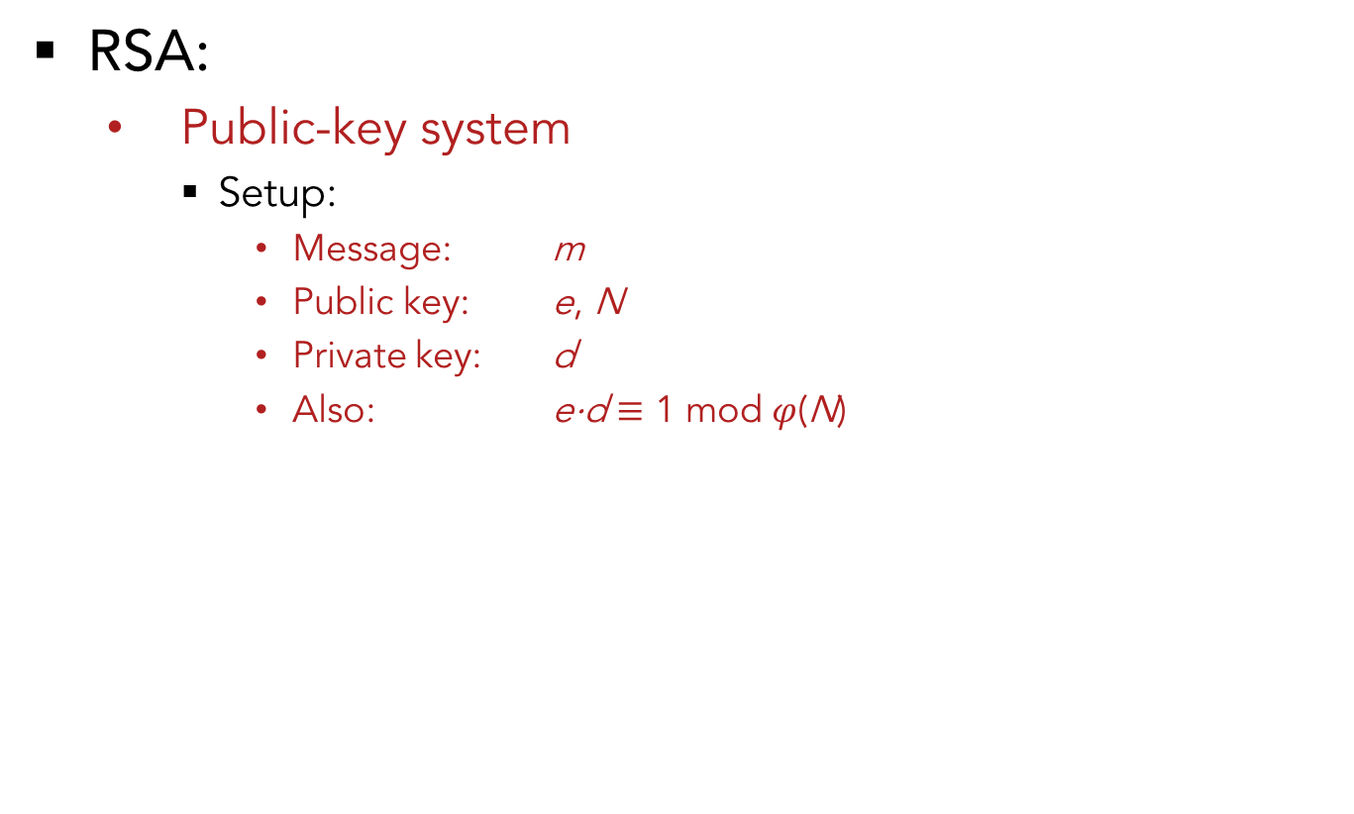
5. RSA’s Potential Problem
RSA:
Public-key system
Setup:
Message: m
Public key: e, N
Private key: d
Also: e⋅d $≡$ 1 mod $φ$(N)

Slide 22
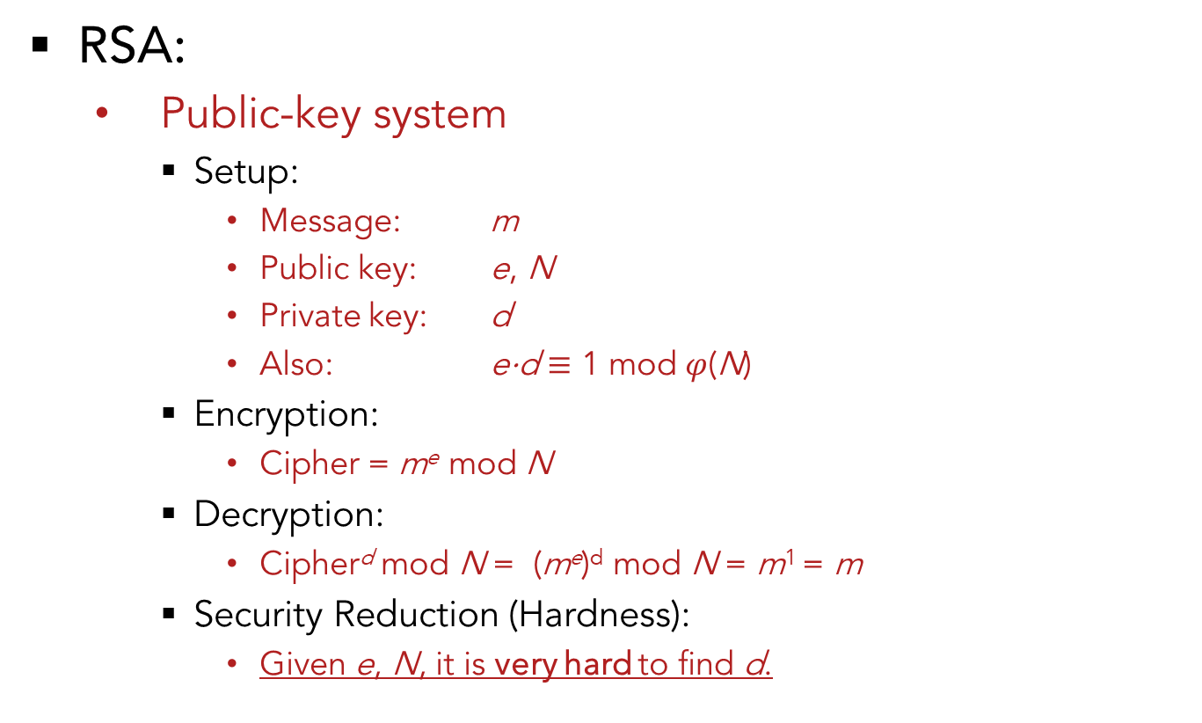
5. RSA’s Potential Problem
RSA:
Public-key system
Setup:
Message: m
Public key: e, N
Private key: d
Also: e⋅d $≡$ 1 mod $φ$(N)
Encryption:
Cipher = m^{e} mod N
Decryption:
Cipher^{d} mod N = (m^{e})^{d} mod N = m¹ = m
Security Reduction (Hardness):
Given e, N, it is very hard to find d.

Slide 23
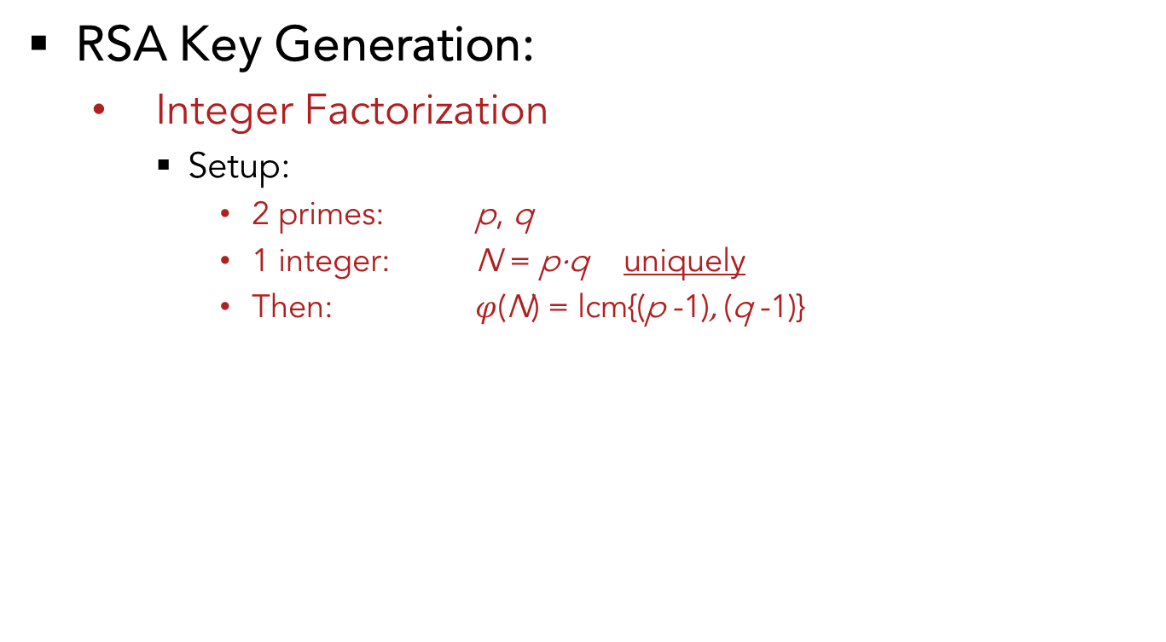
5. RSA’s Potential Problem
RSA Key Generation:
Integer Factorization
Setup:
2 primes: p, q
1 integer: N = p⋅q uniquely
Then: $φ$(N) = lcm{(p -1), (q -1)}

Slide 24
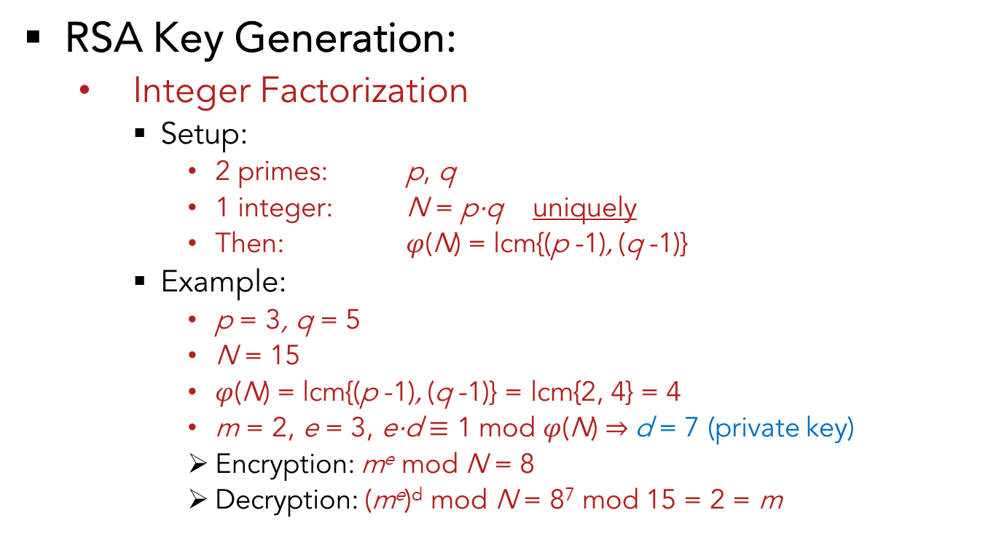
5. RSA’s Potential Problem
RSA Key Generation:
Integer Factorization
Setup:
2 primes: p, q
1 integer: N = p⋅q uniquely
Then: $φ$(N) = lcm{(p -1), (q -1)}
Example:
p = 3, q = 5
N = 15
$φ$(N) = lcm{(p -1), (q -1)} = lcm{2, 4} = 4
m = 2, e = 3, e⋅d $≡$ 1 mod $φ$(N) ⇒ d = 7 (private key)
Encryption: m^{e} mod N = 8
Decryption: (m^{e})^{d} mod N = 8⁷ mod 15 = 2 = m

Slide 25
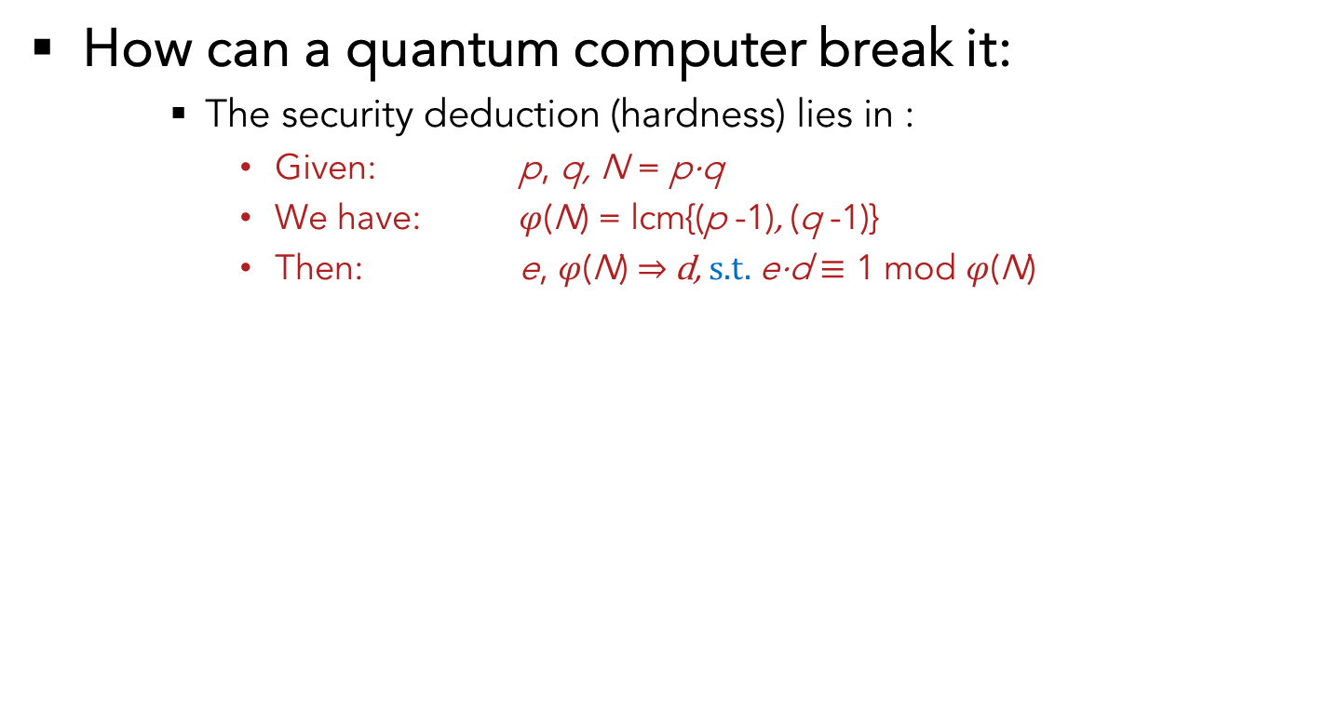
5. RSA’s Potential Problem
How can a quantum computer break it:
The security deduction (hardness) lies in :
Given: p, q, N = p⋅q
We have: $φ$(N) = lcm{(p -1), (q -1)}
Then: e, $φ$(N) ⇒ d, s.t. e⋅d $≡$ 1 mod $φ$(N)

Slide 26
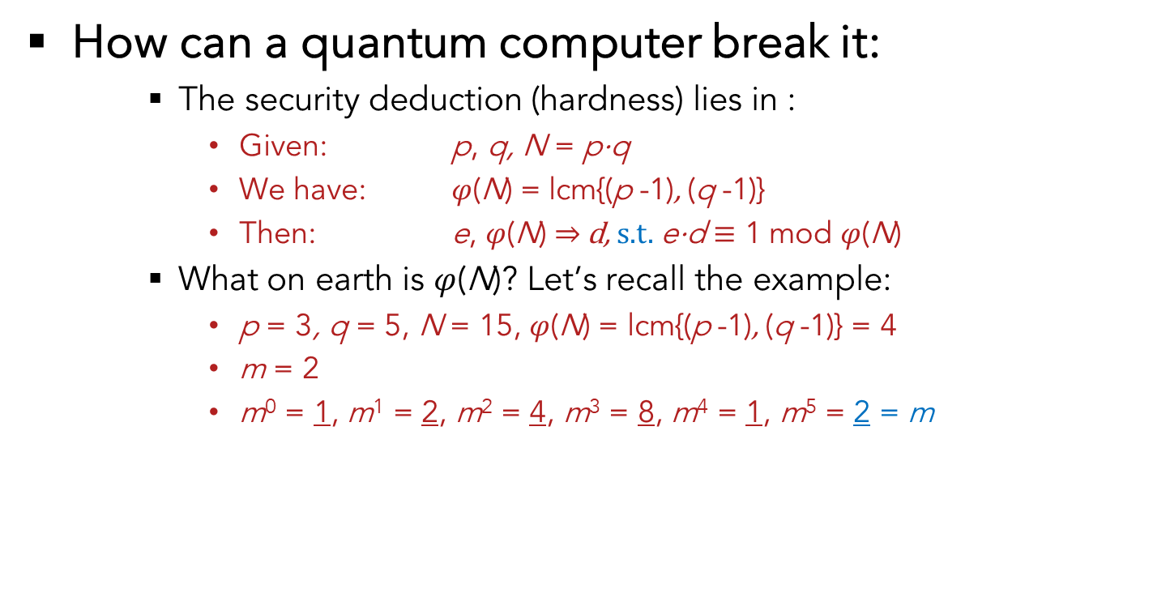
5. RSA’s Potential Problem
How can a quantum computer break it:
The security deduction (hardness) lies in :
Given: p, q, N = p⋅q
We have: $φ$(N) = lcm{(p -1), (q -1)}
Then: e, $φ$(N) ⇒ d, s.t. e⋅d $≡$ 1 mod $φ$(N)
What on earth is $φ$(N)? Let’s recall the example:
p = 3, q = 5, N = 15, $φ$(N) = lcm{(p -1), (q -1)} = 4
m = 2
m⁰ = 1, m¹ = 2, m² = 4, m³ = 8, m⁴ = 1, m⁵ = 2 = m
Period !

Slide 27
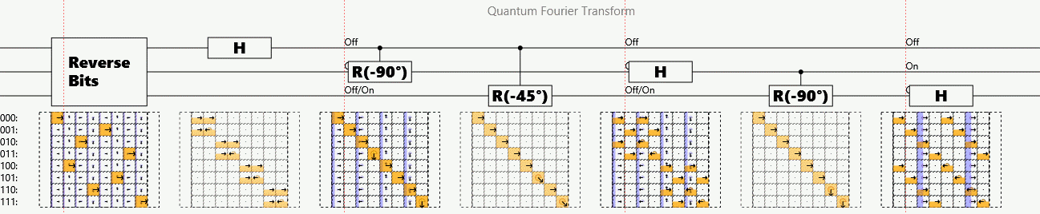
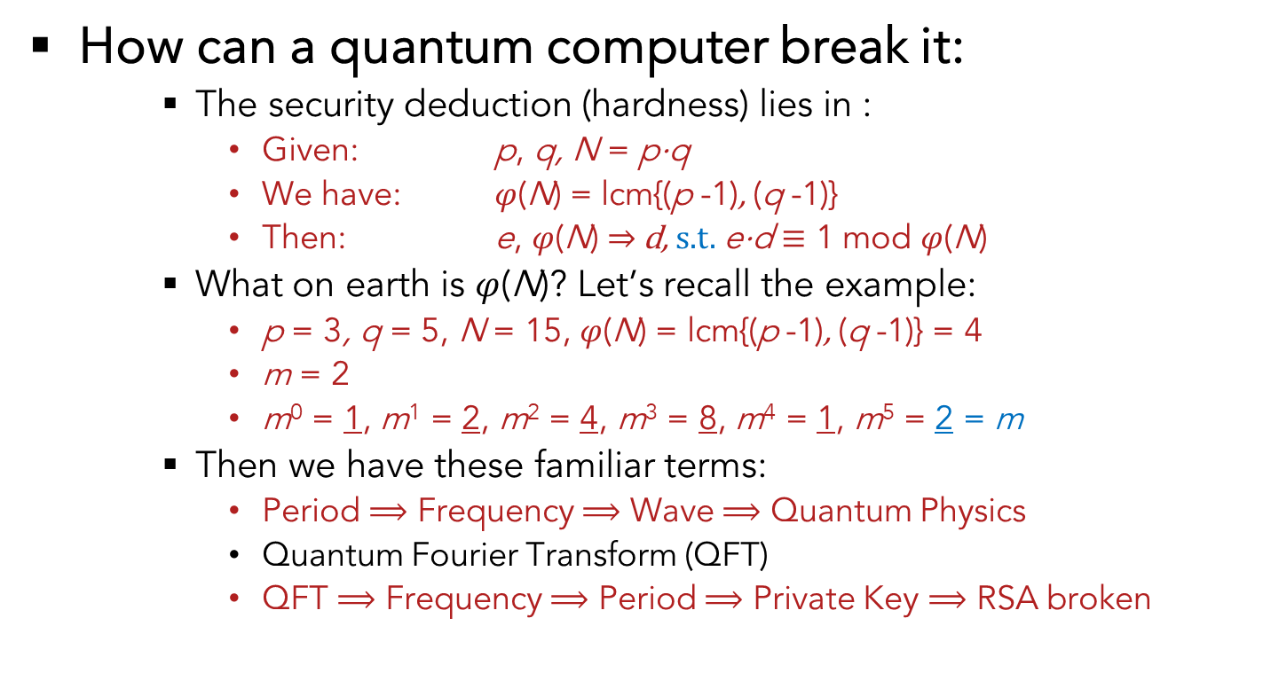
5. RSA’s Potential Problem
How can a quantum computer break it:
The security deduction (hardness) lies in :
Given: p, q, N = p⋅q
We have: $φ$(N) = lcm{(p -1), (q -1)}
Then: e, $φ$(N) ⇒ d, s.t. e⋅d $≡$ 1 mod $φ$(N)
What on earth is $φ$(N)? Let’s recall the example:
p = 3, q = 5, N = 15, $φ$(N) = lcm{(p -1), (q -1)} = 4
m = 2
m⁰ = 1, m¹ = 2, m² = 4, m³ = 8, m⁴ = 1, m⁵ = 2 = m
Then we have these familiar terms:
Period $⟹$ Frequency $⟹$ Wave $⟹$ Quantum Physics
Quantum Fourier Transform (QFT)
QFT $⟹$ Frequency $⟹$ Period $⟹$ Private Key $⟹$ RSA broken
Period !

Slide 28
Presentation Flow
Security problems brought up by quantum computers
How pressing is the security issue?
RSA’s vulnerability under quantum computing
Public-key systems for post-quantum era
Code-based encryption
Lattice-based encryption
Hardware implementation for the primitives

Slide 29
6. Post-quantum Secure Encryptions
Recall that,
NIST
Evaluating 69 submissions of post-quantum encryption schemes in 2018, to bring up a possible standard (like AES):
21 lattice-based
18 code-based
Some hash-based
Similar to the Lamport OTK scheme. Only can do digital signature, not for encryption or key-exchange.
Some others

Slide 30
6. Code-based Encryption
McEliece cryptosystem
Error Correction Code (ECC)
A (n, k, t) ECC code C:
k: # of information bits
n: # of total bits in a codeword (with r = n-k redundant bits)
t: # of random errors C is capable to correct

Slide 31

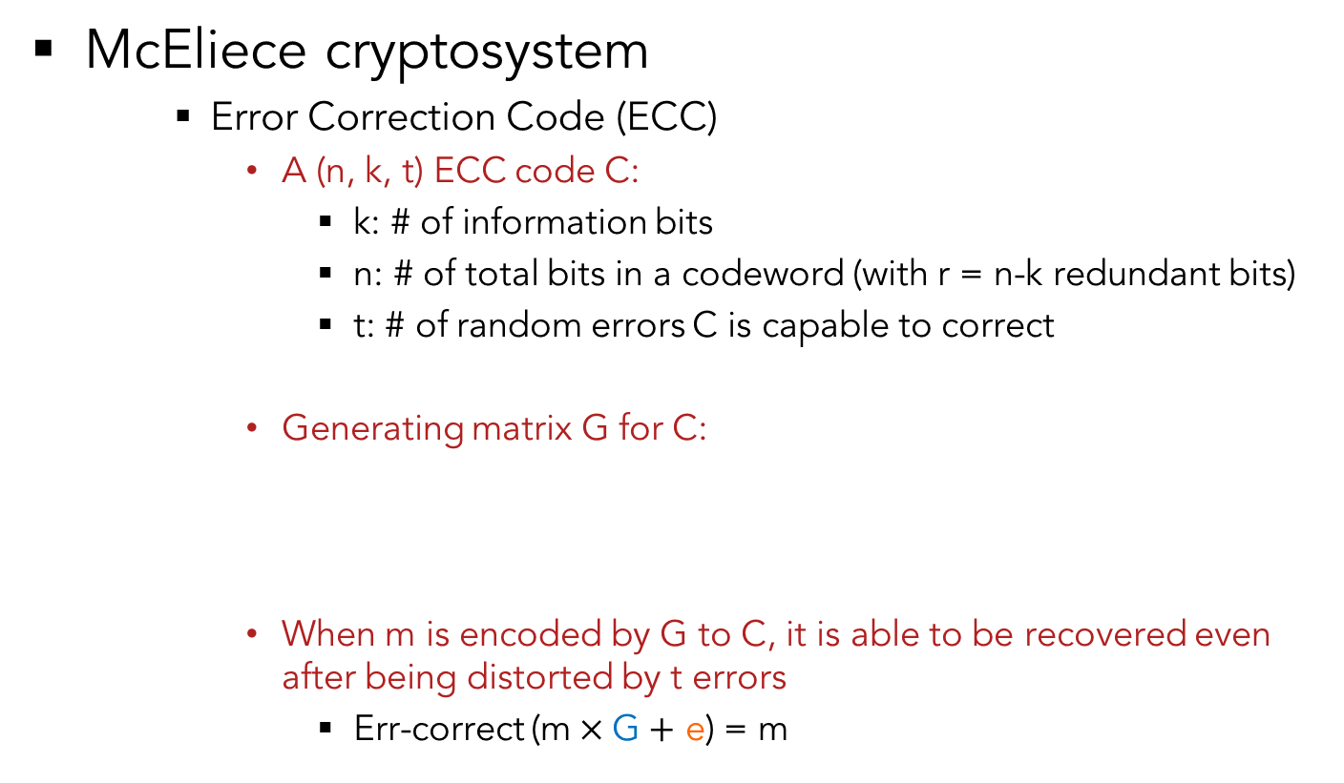

6. Code-based Encryption
McEliece cryptosystem
Error Correction Code (ECC)
A (n, k, t) ECC code C:
k: # of information bits
n: # of total bits in a codeword (with r = n-k redundant bits)
t: # of random errors C is capable to correct
Generating matrix G for C:
When m is encoded by G to C, it is able to be recovered even after being distorted by t errors
Err-correct (m$×\text{G}+$ e) = m
C
1
n
G
n
$$×$$
k
k
$$=$$
1
m

Slide 32
6. Code-based Encryption
McEliece cryptosystem
Error Correction Code (ECC)
A (n, k, t) ECC code C:
k: # of information bits
n: # of total bits in a codeword (with r = n-k redundant bits)
t: # of random errors C is capable to correct
Generating matrix G for C:
When m is encoded by G to C, it is able to be recovered even after being distorted by t errors
Err-correct (m$×\text{G}+$ e) = m
C
Nothing secret to anyone.
1
n
G
n
$$×$$
k
k
$$=$$
1
m

Slide 33

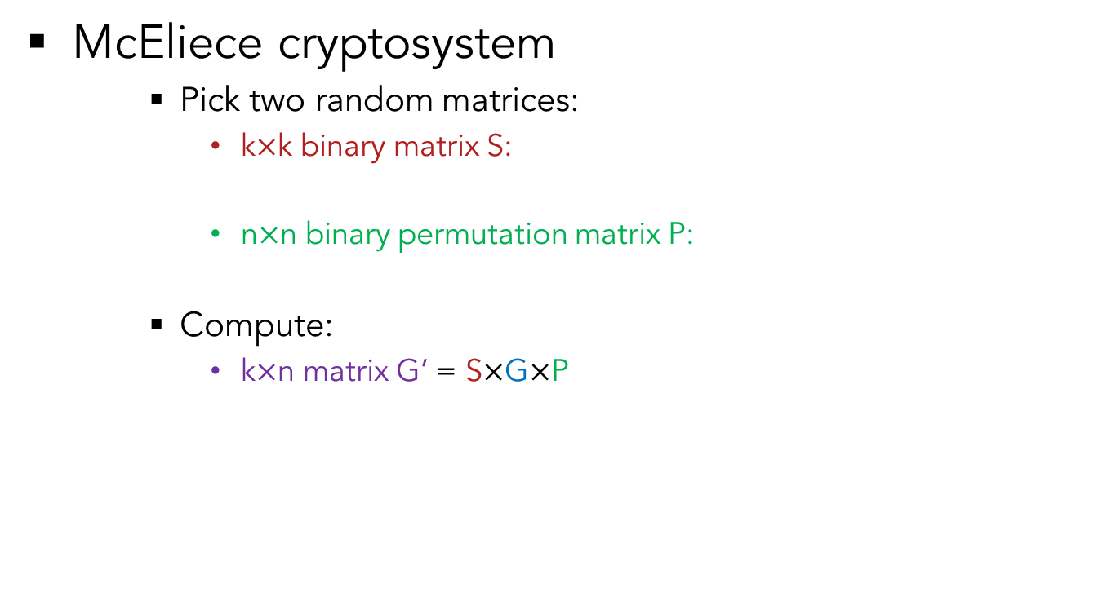


6. Code-based Encryption
k
McEliece cryptosystem
Pick two random matrices:
k$×$k binary matrix S:
n$×$n binary permutation matrix P:
Compute:
k$×$n matrix G’ = S$×$G$×$P
s
k
P
n
n
s
G
P
G’
$$×$$
$$×$$
$$=$$

Slide 34
6. Code-based Encryption
k
McEliece cryptosystem
Pick two random matrices:
k$×$k binary matrix S:
n$×$n binary permutation matrix P:
Compute:
k$×$n matrix G’ = S$×$G$×$P
s
k
P
n
n
s
G
P
G’
$$×$$
$$×$$
$$=$$
For obfuscation,
s.t. G’s leaks no information of G

Slide 35
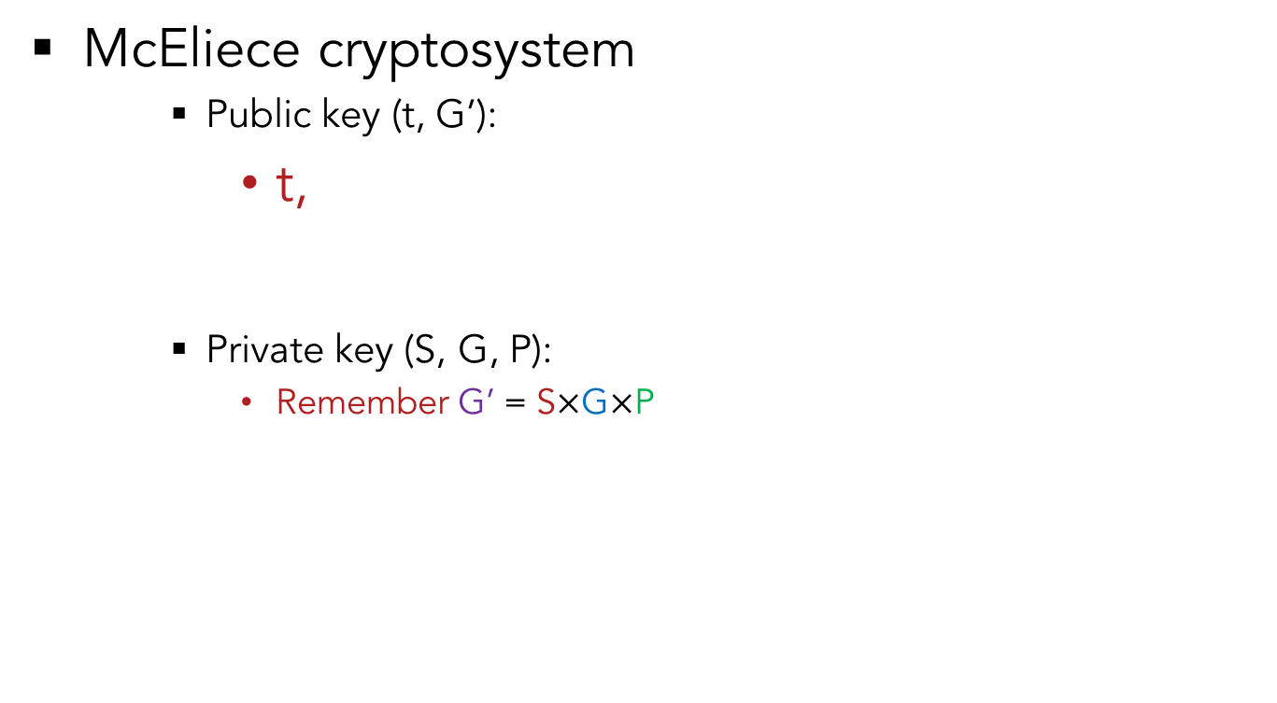
6. Code-based Encryption
McEliece cryptosystem
Public key (t, G’):
t,
Private key (S, G, P):
Remember G’ = S$×$G$×$P
G’
s
G
P

Slide 36




6. Code-based Encryption
McEliece cryptosystem
Encryption (Bob to Alice):
Message (plaintext) encrypted to codeword
Codeword obfuscated by error to cipher
C
G’
$$×$$
m
$$=$$
C
e (t of 1’s)
Cipher
$$+$$
$$=$$

Slide 37
6. Code-based Encryption
McEliece cryptosystem
Encryption (Bob to Alice):
Message (plaintext) encrypted to codeword
Codeword obfuscated by error to cipher
C
G’
Can be arbitrarily chosen. Will be eliminated anyways but makes attack difficult.
$$×$$
m
$$=$$
C
e (t of 1’s)
Cipher
$$+$$
$$=$$

Slide 38
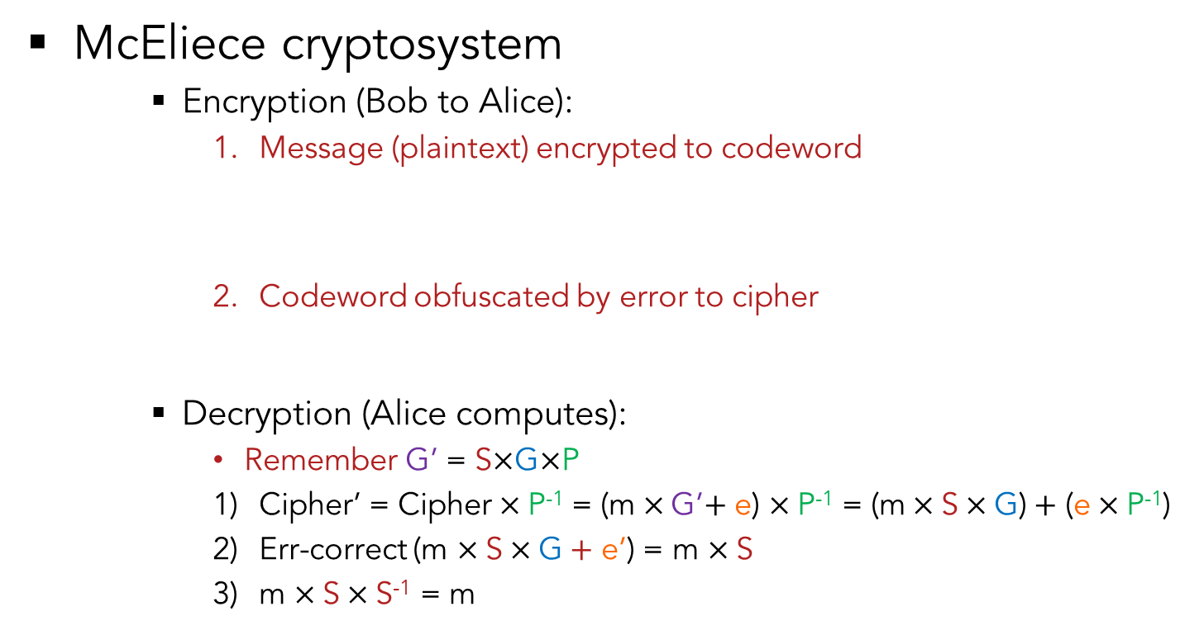
6. Code-based Encryption
McEliece cryptosystem
Encryption (Bob to Alice):
Message (plaintext) encrypted to codeword
Codeword obfuscated by error to cipher
Decryption (Alice computes):
Remember G’ = S$×$G$×$P
Cipher’ = Cipher$×$P⁻¹ = (m$×$G’$+$ e) $×$P⁻¹ = (m$×$S$×\text{G}\text{)}+$ (e$×$P⁻¹)
Err-correct (m $×\text{S}×\text{G}+$ e’) = m $×\text{S}$
m $×\text{S}×\text{S}\text{−1}$ = m
C
G’
Can be arbitrarily chosen. Will be eliminated anyways but makes attack difficult.
$$×$$
m
$$=$$
C
e (t of 1’s)
Cipher
$$+$$
$$=$$

Slide 39
6. Code-based Encryption
McEliece cryptosystem
Encryption (Bob to Alice):
Message (plaintext) encrypted to codeword
Codeword obfuscated by error to cipher
Decryption (Alice computes):
Remember G’ = S$×$G$×$P
Cipher’ = Cipher$×$P⁻¹ = (m$×$G’$+$ e) $×$P⁻¹ = (m$×$S$×\text{G}\text{)}+$ (e$×$P⁻¹)
Err-correct (m $×\text{S}×\text{G}+$ e’) = m $×\text{S}$
m $×\text{S}×\text{S}\text{−1}$ = m
C
G’
Can be arbitrarily chosen. Will be eliminated anyways but makes attack difficult.
$$×$$
m
$$=$$
C
e (t of 1’s)
Cipher
$$+$$
$$=$$
Attacker does not know: S, G, P
Thus he/she cannot compute:
S⁻¹, Err-correct(e), P⁻¹
Therefore, he/she does not know m

Slide 40
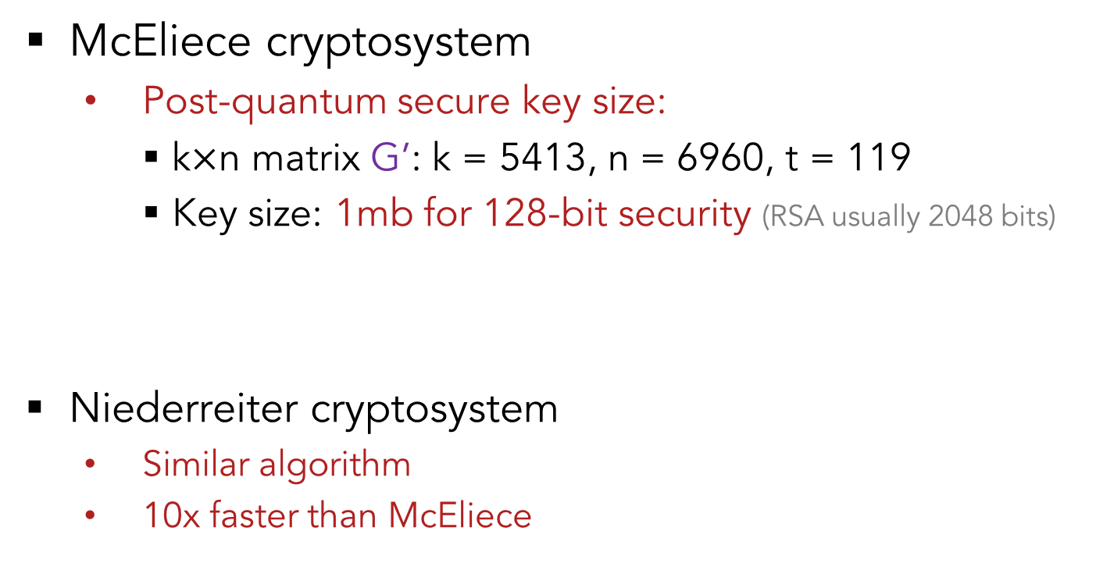
6. Code-based Encryption
McEliece cryptosystem
Post-quantum secure key size:
k$×$n matrix G’: k = 5413, n = 6960, t = 119
Key size: 1mb for 128-bit security (RSA usually 2048 bits)
Niederreiter cryptosystem
Similar algorithm
10x faster than McEliece
G’

Slide 41
6. Lattice-based Encryption
Lattice-based Cryptosystem
Most popular
Leading algorithm in the post-quantum era
Has some famous variants:
NTRU (now a commercialized company)
Learning with Errors (LWE)
Ring-LWE
More feasible in hardware than RSA

Slide 42
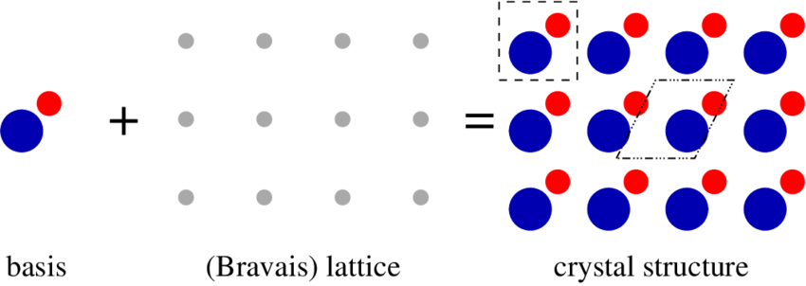
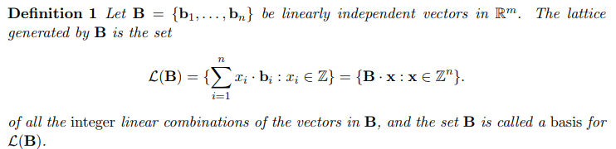
6. Lattice-based Encryption
Lattice-based Cryptosystem
Originally from crystals
Actual math is more complicated (discreet vector space)

Slide 43
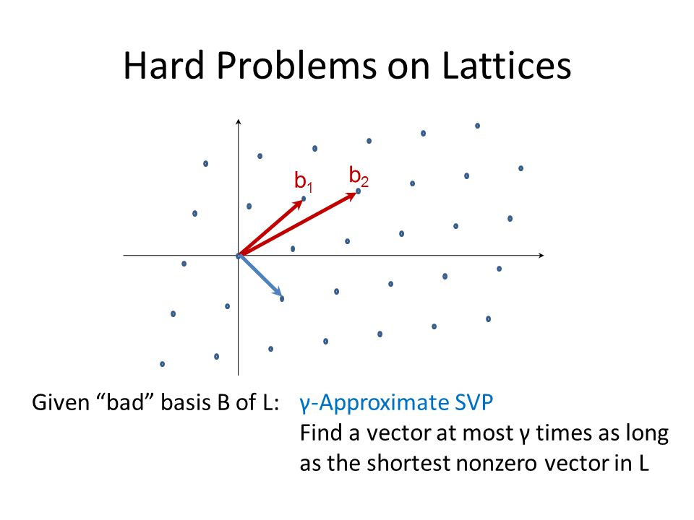
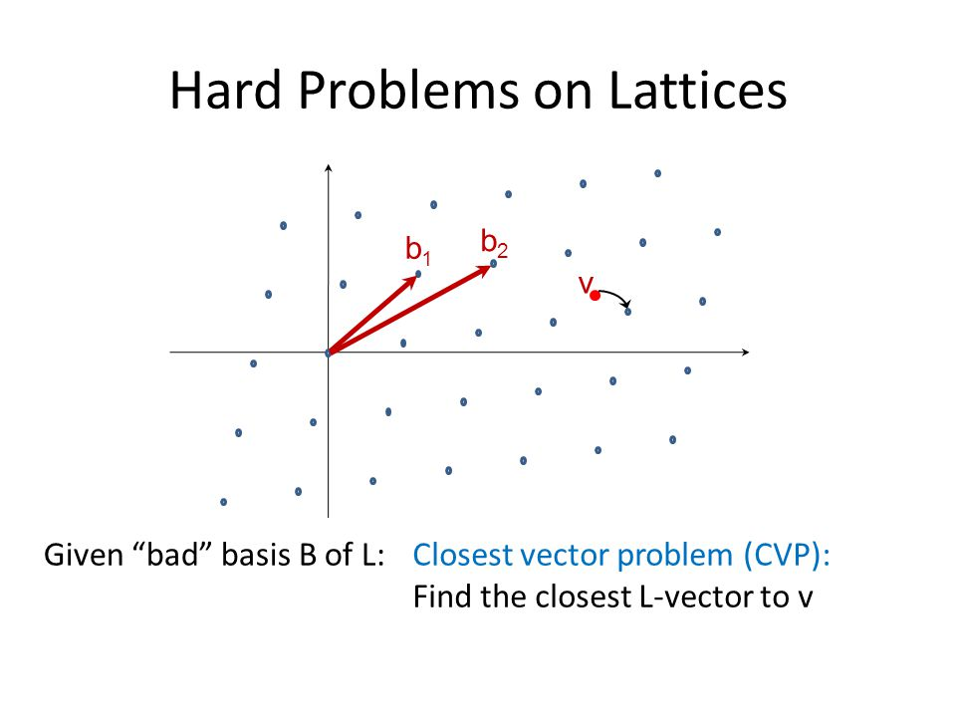
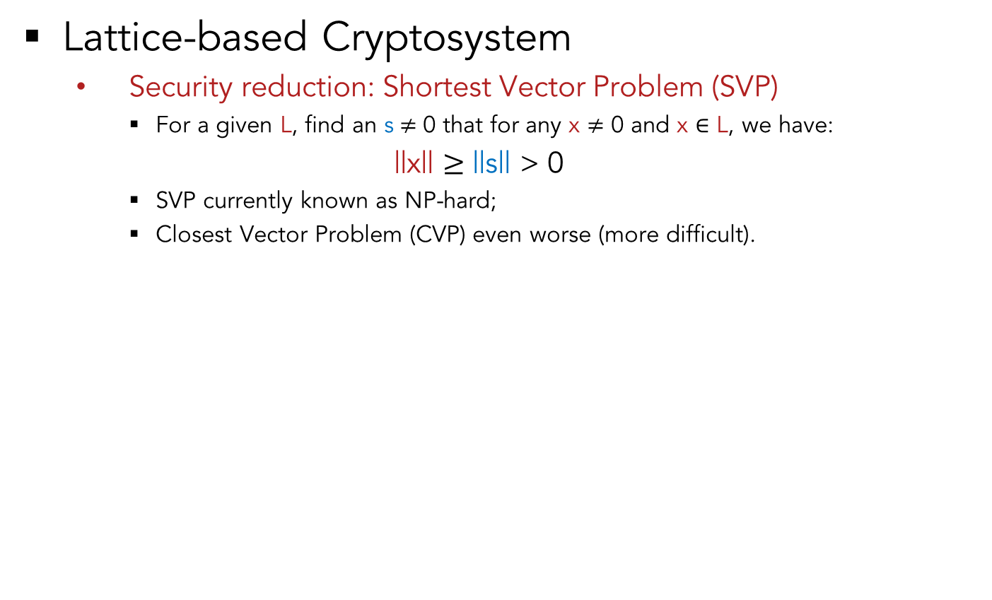
6. Lattice-based Encryption
Lattice-based Cryptosystem
Security reduction: Shortest Vector Problem (SVP)
For a given L, find an s$≠$ 0 that for any x $≠$ 0 and x $∈$ L, we have:
||x|| $≥$ ||s|| > 0
SVP currently known as NP-hard;
Closest Vector Problem (CVP) even worse (more difficult).

Slide 44

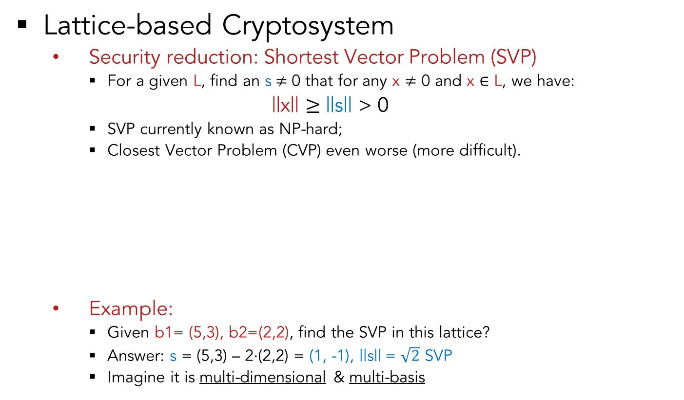
6. Lattice-based Encryption
Lattice-based Cryptosystem
Security reduction: Shortest Vector Problem (SVP)
For a given L, find an s$≠$ 0 that for any x $≠$ 0 and x $∈$ L, we have:
||x|| $≥$ ||s|| > 0
SVP currently known as NP-hard;
Closest Vector Problem (CVP) even worse (more difficult).
Example:
Given b1= (5,3), b2=(2,2), find the SVP in this lattice?
Answer: s = (5,3) – 2$⋅$(2,2) = (1, -1), ||s|| = $\sqrt{2}$ SVP
Imagine it is multi-dimensional & multi-basis

Slide 45
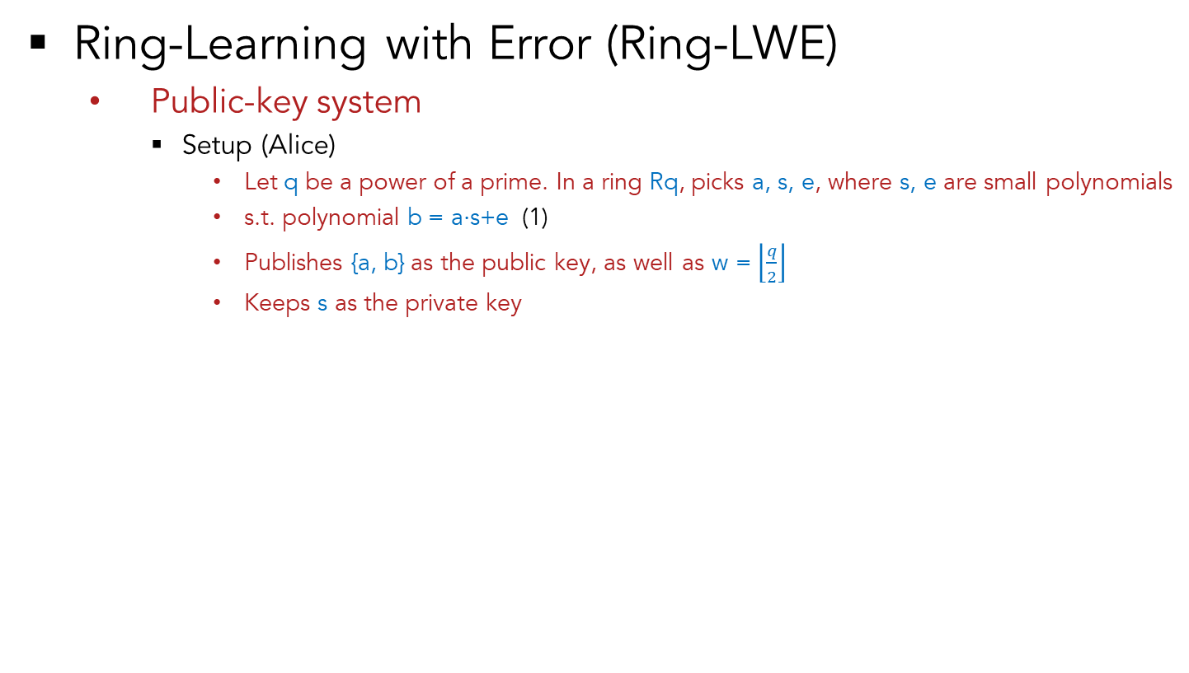
6. Lattice-based Encryption
Ring-Learning with Error (Ring-LWE)
Public-key system
Setup (Alice)
Let q be a power of a prime. In a ring Rq, picks a, s, e, where s, e are small polynomials
s.t. polynomial b = a$⋅$s+e (1)
Publishes {a, b} as the public key, as well as w = $\left\lfloor \frac{q}{2}\right\rfloor$
Keeps s as the private key

Slide 46
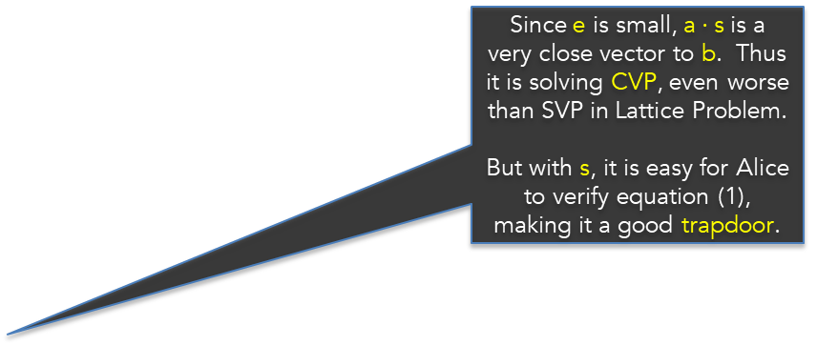
6. Lattice-based Encryption
Since e is small, a $⋅$s is a very close vector to b. Thus it is solving CVP, even worse than SVP in Lattice Problem.
But with s, it is easy for Alice to verify equation (1), making it a good trapdoor.
Ring-Learning with Error (Ring-LWE)
Public-key system
Setup (Alice)
Let q be a power of a prime. In a ring Rq, picks a, s, e, where s, e are small polynomials
s.t. polynomial b = a$⋅$s+e (1)
Publishes {a, b} as the public key, as well as w = $\left\lfloor \frac{q}{2}\right\rfloor$
Keeps s as the private key

Slide 47
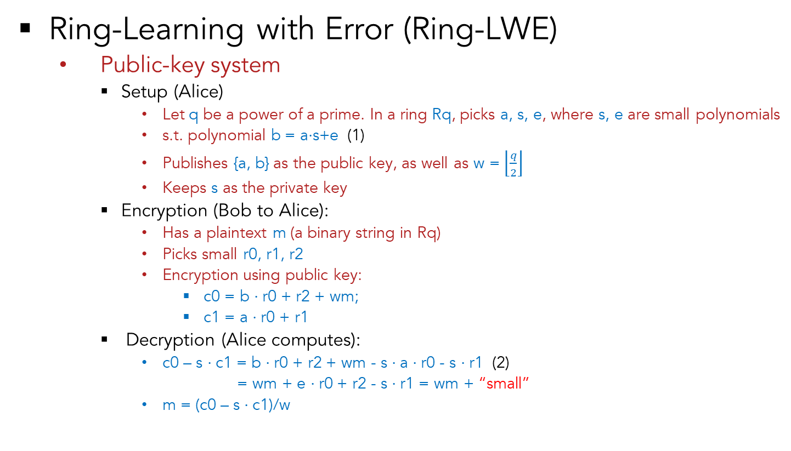

6. Lattice-based Encryption
Ring-Learning with Error (Ring-LWE)
Public-key system
Setup (Alice)
Let q be a power of a prime. In a ring Rq, picks a, s, e, where s, e are small polynomials
s.t. polynomial b = a$⋅$s+e (1)
Publishes {a, b} as the public key, as well as w = $\left\lfloor \frac{q}{2}\right\rfloor$
Keeps s as the private key
Encryption (Bob to Alice):
Has a plaintext m (a binary string in Rq)
Picks small r0, r1, r2
Encryption using public key:
c0 = b $⋅$r0 + r2 + wm;
c1 = a $⋅$r0 + r1
Decryption (Alice computes):
c0 – s $⋅$c1 = b $⋅$r0 + r2 + wm - s $⋅$a $⋅$r0 - s $⋅$r1 (2)
= wm + e $⋅$r0 + r2 - s $⋅$r1 = wm + “small”
m = (c0 – s $⋅$c1)/w
$$\left\lceil 1\right.\left.111q1111\right\rfloor$$
Taking the nearest integer

Slide 48
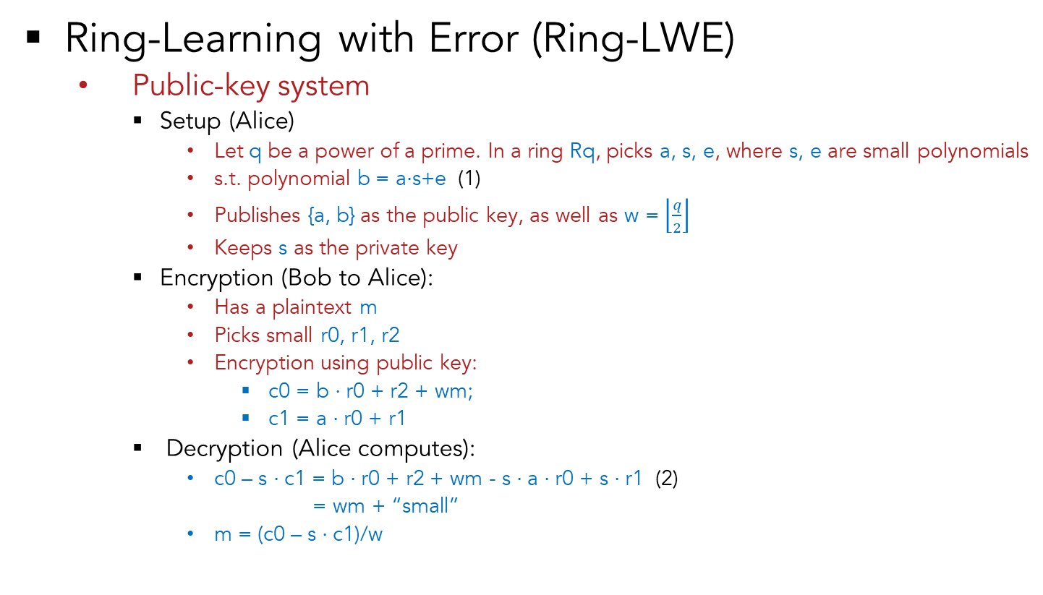
6. Lattice-based Encryption
Ring-Learning with Error (Ring-LWE)
Public-key system
Setup (Alice)
Let q be a power of a prime. In a ring Rq, picks a, s, e, where s, e are small polynomials
s.t. polynomial b = a$⋅$s+e (1)
Publishes {a, b} as the public key, as well as w = $\left\lfloor \frac{q}{2}\right\rfloor$
Keeps s as the private key
Encryption (Bob to Alice):
Has a plaintext m
Picks small r0, r1, r2
Encryption using public key:
c0 = b $⋅$r0 + r2 + wm;
c1 = a $⋅$r0 + r1
Decryption (Alice computes):
c0 – s $⋅$c1 = b $⋅$r0 + r2 + wm - s $⋅$a $⋅$r0 + s $⋅$r1 (2)
= wm + “small”
m = (c0 – s $⋅$c1)/w
e, r0, r1, r2 will be eliminated easily by Alice, but they make attacker’s life so much harder.
$$\left\lceil 1\right.\left.111q1111\right\rfloor$$
Taking the nearest integer

Slide 49
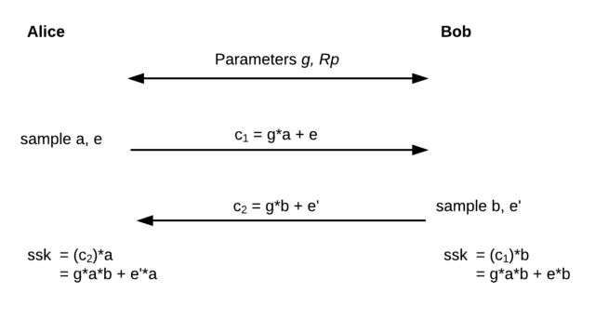


6. Lattice-based Encryption
Ring-Learning with Error (Ring-LWE)
Key-exchange
$$\left\lceil 1\right.\left.11111\right\rfloor$$
$$\left\lceil 1\right.\left.11111\right\rfloor$$
Taking the nearest integer

Slide 50
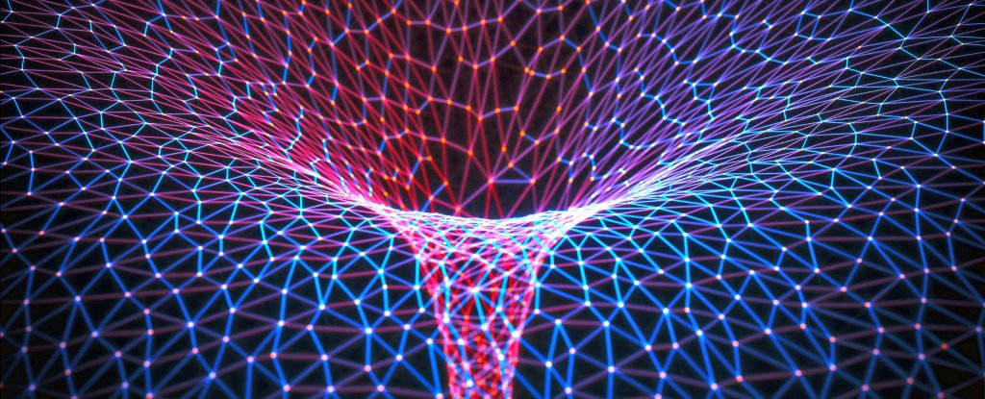
6. Lattice-based Encryption
Why Lattice-based encryption important?
Public-key system that is secure in post-quantum era
Key-exchange system that is secure in post-quantum era
Fully Homomorphic Encryption (FHE) is based on it
Quantum computation verification and HE* are based on it
∗ Urmila Mahadev, Classical Homomorphic Encryption for Quantum Circuits, 2018

Slide 51
Presentation Flow
Security problems brought up by quantum computers
How pressing is the security issue?
RSA’s vulnerability under quantum computing
Public-key systems for post-quantum era
Code-based encryption
Lattice-based encryption
Hardware implementation for the primitives

Slide 52
7. FPGA Implementation of the Primitives
Ring-LWE Feasible?
Smaller key size: 7,000 bits (yes, smaller) for public key with 128-bit security (code-based 1mb)
Simpler operations: number-theoretic transform(NTT), field multiplication, addition, scalar division
Faster than RSA, who has exponentiation.
Quite a few HDL codes for Ring-LWE key exchange, but not much of public-key encryption
Getting in touch with a most-cited author now for his HDL code, or I have to build my own.

Slide 53

Any Questions?

